Slide 1
Multimedia System and Virtual Environment
CSE – 310
Lecture 12
Multimedia Operating System
Dept. of Computer Science and Engineering, University of Rajshahi

Slide 2
Outline
Image Compression
Data vs Information
Data Redundancy
Coding
Interpixel
Psychovisual
Dept. of Computer Science and Engineering, University of Rajshahi

Slide 3
Resources Classification
Resource is a system entity required by tasks for manipulating data
Active versus Passive Resources (CPU – active; main memory – passive)
Shared versus Exclusive Resources (CPU – shared; audio device – exclusive)
Single Versus Multiple Resources (single CPU in PC, multiple CPU in multi-core system
Dept. of Computer Science and Engineering, University of Rajshahi

Slide 4
Resource Management
Limited capacity in digital distributed systems despite data compression and usage of new technologies
Need faithfulness for processing of continuous data by every hardware and software component along the data path
Competition for resources exist in an integrated multimedia system
Dept. of Computer Science and Engineering, University of Rajshahi

Slide 5
Real-Time and Deadlines
Real-time system– system in which correctness of computation depends not only on obtaining the right results, but also providing them on time
Examples: control of temperature in a chemical plant; control of a flight simulator
Deadline– represents the latest acceptable time for the result delivery
Dept. of Computer Science and Engineering, University of Rajshahi

Slide 6
Preemptive and Non-preemptive
Preemptive is a practice of an operating system if it allows the running task to be suspended when a task of higher priority becomes ready (or a task of equal priority is granted a turn).
Non-preemptive schedulers are easier to be implemented but less appropriate for embedded systems, which must be responsive to external events
Dept. of Computer Science and Engineering, University of Rajshahi

Slide 7
Operating Systems with Multimedia Support
Multimedia needs real-time processing
Operating systems with multimedia support differ from the traditional operating systems in three main ways:
Process scheduling
File system
Disk scheduling

Slide 8
Scheduling Homogeneous Processes
Consider a simple video server to support the display of a fixed number of movies, all using the same frame rate, video resolution, data rate, and other parameters
For each movie a single process (or thread) reads the movie from the disk one frame at a time and then transmit that frame to the user

Slide 9
Scheduling Homogeneous Processes
Since all processes are equally important, do the same activity for each movie, round-robin scheduling is fine
What is needed is a timing mechanism to make sure each process runs at the correct frequency (30 frames/sec for NTSC and 25 frames/sec for PAL and SECAM)
A master clock ticks at the required frequency (say 25 times per second in the case of PAL). At each tick, all processes run one after the other and in the same order.
Process finishing work (frame transmitted) suspends itself and waits for the next tick
As long as the number of processes is small enough that all the work can be done in one frame time, round-robin is sufficient

Slide 10
Necessity of Real-Time Scheduling
Number of users changes as viewers come and go, frame sizes vary due to compression, and different movies may have different resolutions.
This means several processes have to run at different frequencies, with different amount of work, and with different deadlines.

Slide 11
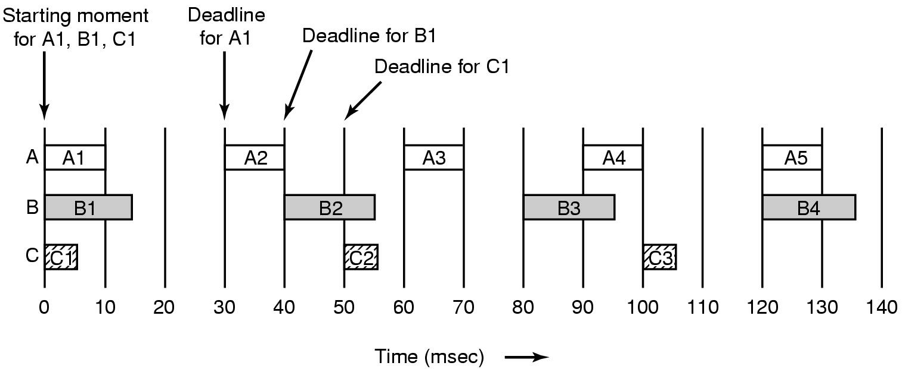
General Real-Time Scheduling
Process | Frames/sec | Deadline (msec) | CPU time/frame (msec)
A | 30 | 30 | 10
B | 25 | 40 | 15
C | 20 | 50 | 5

Slide 12
General Real-Time Scheduling
If process i has a period P_{i} msec and requires C_{i} msec of CPU time per frame, the system is schedulable if and only if
m
C_{i}
Σ
≤ 1
P_{i}
i = 1
where m is the number of processes (0.808 for the previous example)
Real-time algorithms can be either static or dynamic
RMS (Rate Monotonic Scheduling)
EDF (Earliest Deadline First Scheduling)

Slide 13
Rate- Monotonic Scheduling (RMS)
Designed/proved by Liu and Layland 1973
Policy: task with highest rate has highest priority
Static and optimal, priority-driven
Optimal means that there no other static algorithm that is able to schedule a RT task which can’t be scheduled by RMS algorithm
Assumptions:
Tasks are periodic
Each task must complete before next request
All tasks are independent
Run-time of each task request is constant
Any non-periodic task has no required deadline.

Slide 14
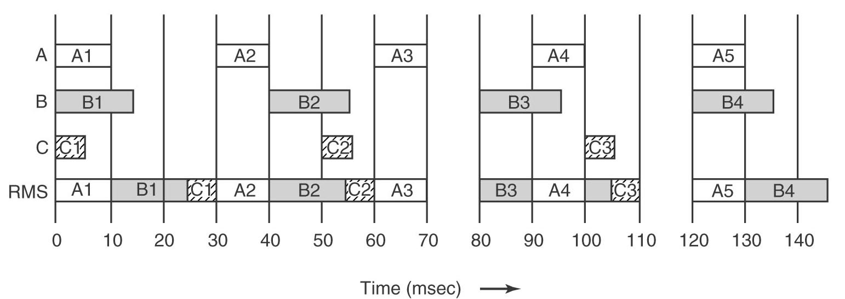
An Example of RMS Scheduling
Process | Frames/sec | Priority | CPU time/frame (msec)
A | 30 | 30 | 10
B | 25 | 25 | 15
C | 20 | 20 | 5

Slide 15
EDF (Earliest Deadline First Scheduling)
EDF is dynamic algorithm that does not require
processes to be periodic.
processes to have the same run time per CPU burst.
The scheduler keeps a list of runnable processes, sorted on deadline.
The algorithm runs the first process on the list, the one with the closest deadline
Whenever a new process becomes ready, the system checks to see if its deadline occurs before that of the currently running process. If so, the running process is preempted

Slide 16
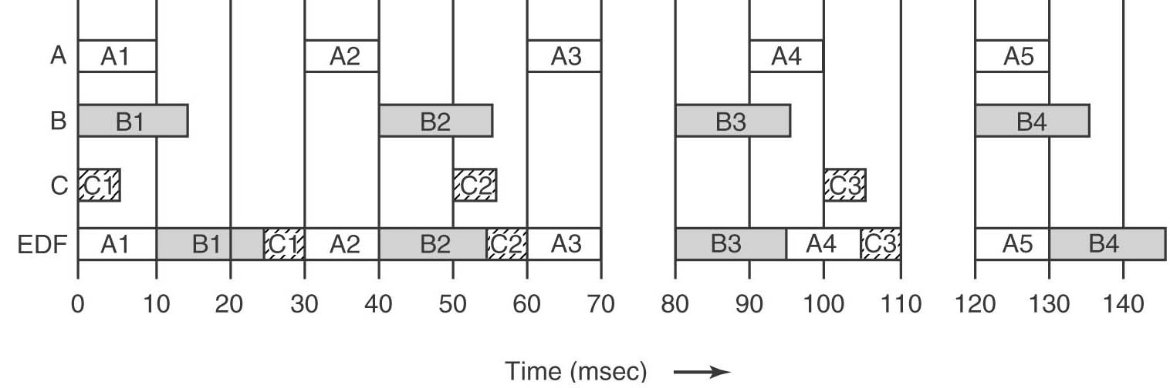
An Example of EDF Scheduling
Deadline times:
A : 0 - 30 - 60 - 90 - 120 - 150
B : 0 - 40 - 80 - 120 – 160
C : 0 – 50 – 100 - 150

Slide 17
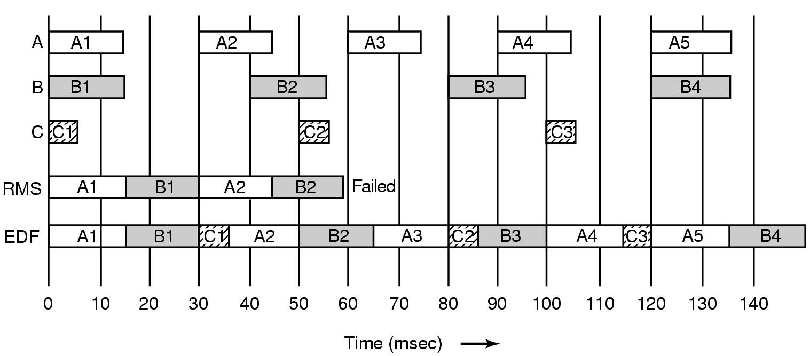
Another example of RMS and EDF
Process A needs 15 msecs instead of 10 msec. RMS fails but EDF works fine.
If the CPU utilization is below an RMS limit RMS can be used else EDF should be chosen.

Slide 18
Why RMS Failed?
RMS only works if the CPU utilization is not too high. Liu and Layland proved that for any system of periodic processes, if
then RMS is guaranteed to work.
Assumes fixed amount of processing per periodic task.
For 3, 4, 5, 10, 20, and 100, the maximum permitted utilization are 0.78, 0.757, 0.743, 0.718, 0.705, and 0.696.

